Slide 1
NODE.JS
(The Backend Of MERN Stack)
Lecture 12

Slide 2
Today’s Agenda
The inquirer module
Modifying package.json
Using Ems import
Creating prompts
Presenting choices
Accepting password
Project 3
Project 4

Slide 3
What is inquirer ?
Inquirer is an 3rd party NPM module that provides an easy way to capture user input in our Node.js CLI applications
It provides several methods for asking questions and returning answers from the user that can be accessed by a .then() promise function.
It even supports the async/await syntax.

Slide 4
Installing inquirer
We can install the inquirer module by using the following command: inside our application folder:
npm install inquirer
Special Note
The latest version of inquirer is inquirer 9.2.6 and it only supports ESM and thus require() will not work.
So either we can install inquirer 8.0.0 so that we can use require()
OR
We can add a new key-value called “type”:”module” in our package.json file and so that we can use the import keyword to import inquirer in our application
Just to understand the new way of using module we will follow the second approach

Slide 5
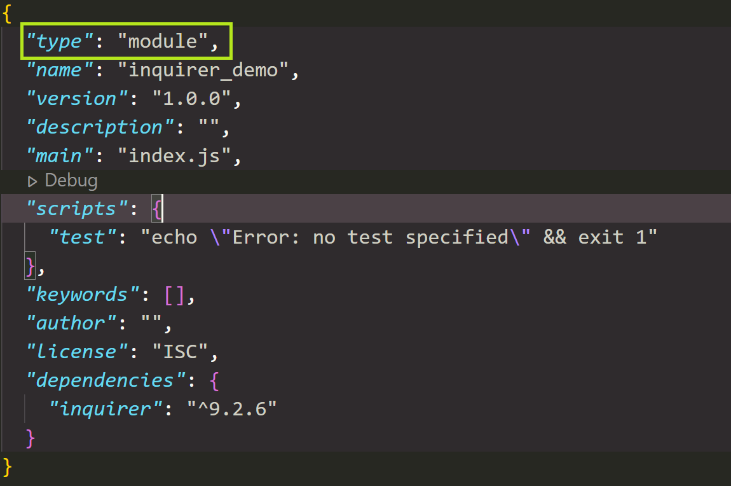
Modified package.json file

Slide 6
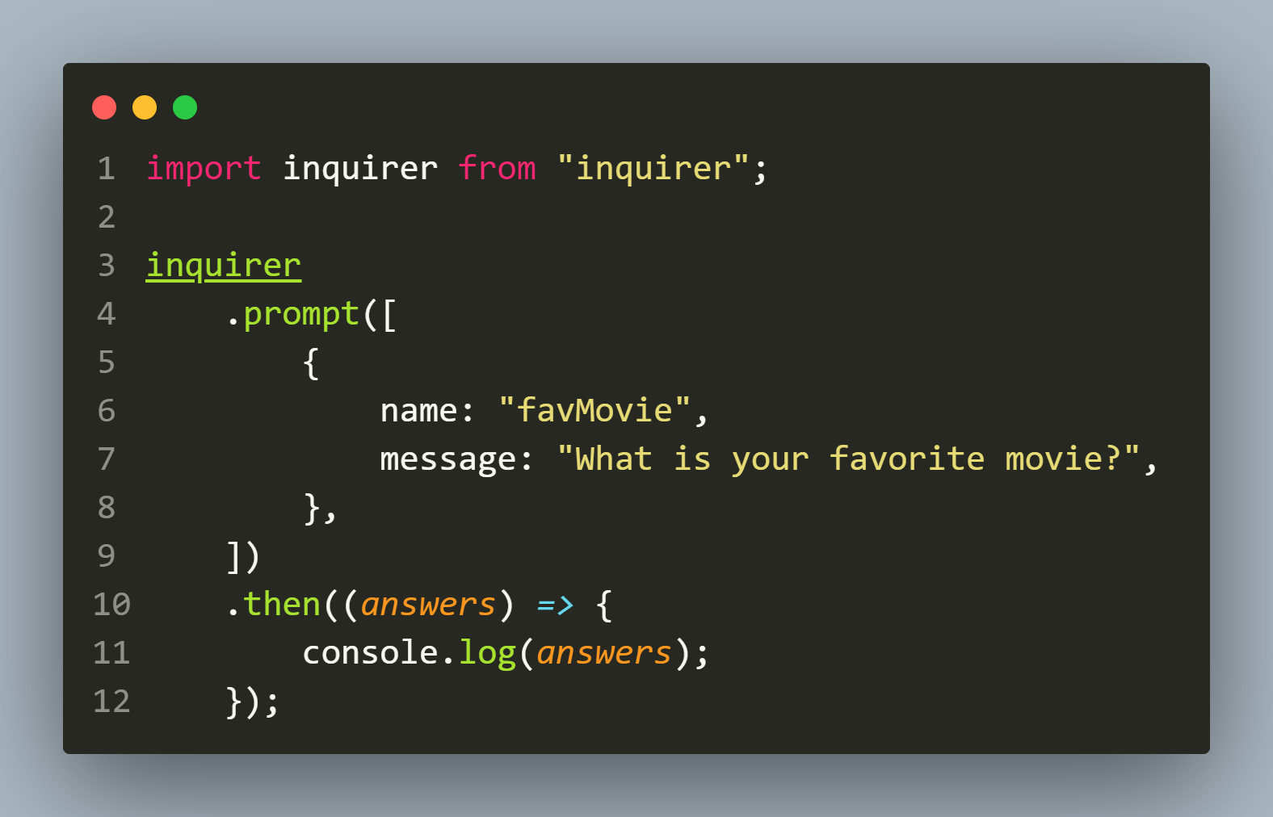

Example 1
The Code
The Output

Slide 7
explanation
Inquirer object has a method called prompt() which after execution returns a promise .
This method accepts an array of JS objects where each object can have several key-value pairs.
The 2 most important key:value pairs are:
message: some text
name: some text

Slide 8
explanation
The key message holds the text to be displayed as question on command prompt.
The key name contains user’s response and is wrapped inside the object sent as argument to the callback of then() when promise gets resolved.
If the promise gets rejected then catch() runs.

Slide 9
Setting up default value
Inquirer allows us to setup a default value when asking the question to the user.
This allows the user to press ENTER without submitting any answer and the default value will be used as his answer.

Slide 10
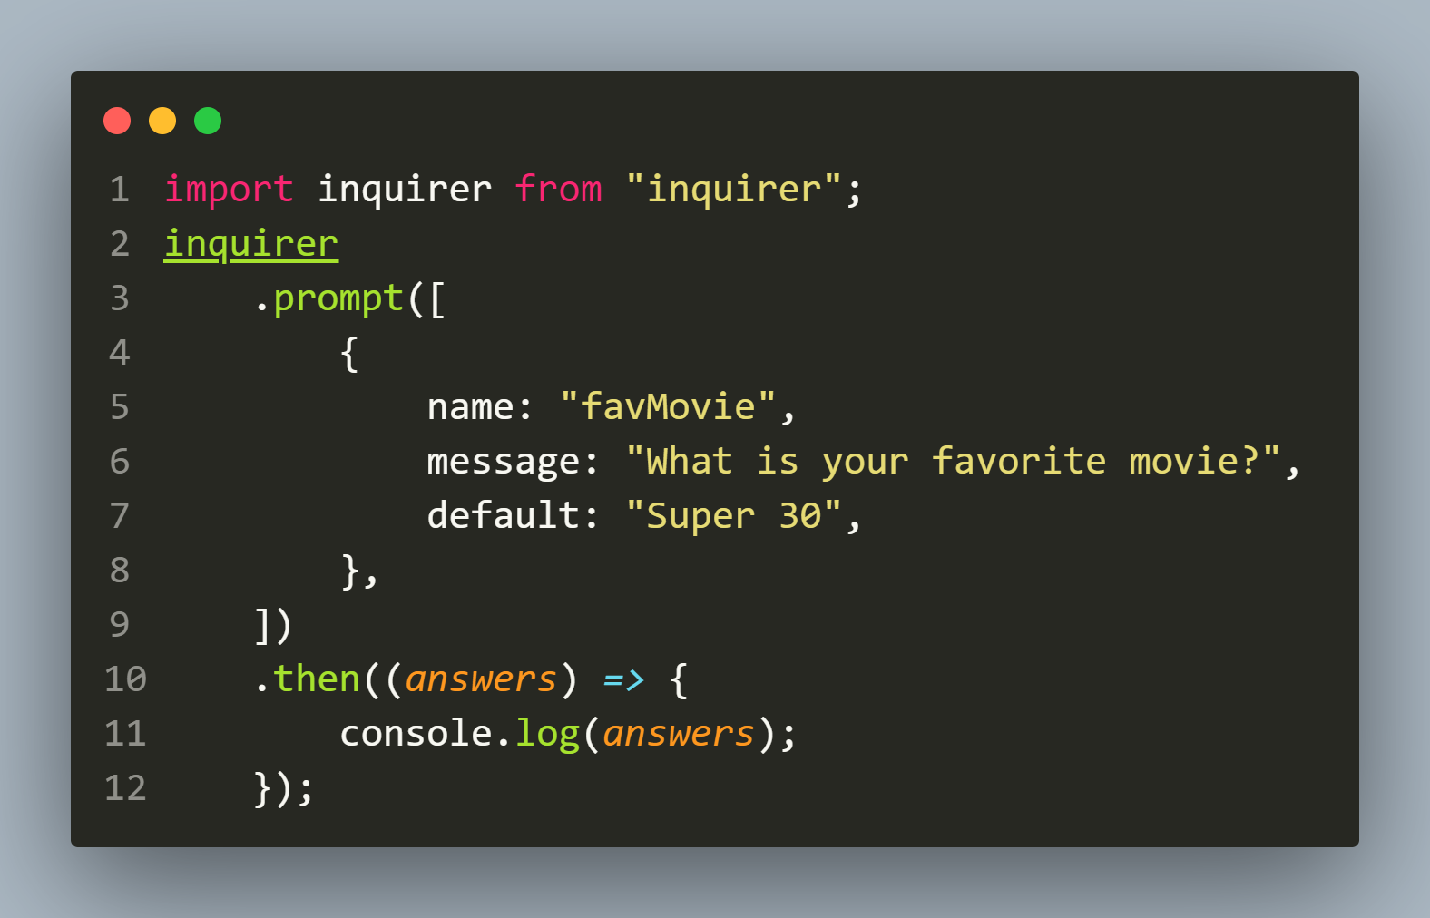


Example 2
The Code
The Output

Slide 11
Creating multiple prompts
We know that the .prompt() method accepts an array of objects.
That’s because we can string a series of prompt questions together and all of the answers will be available by name as part of the answers variable once all of the prompts have been resolved.

Slide 12
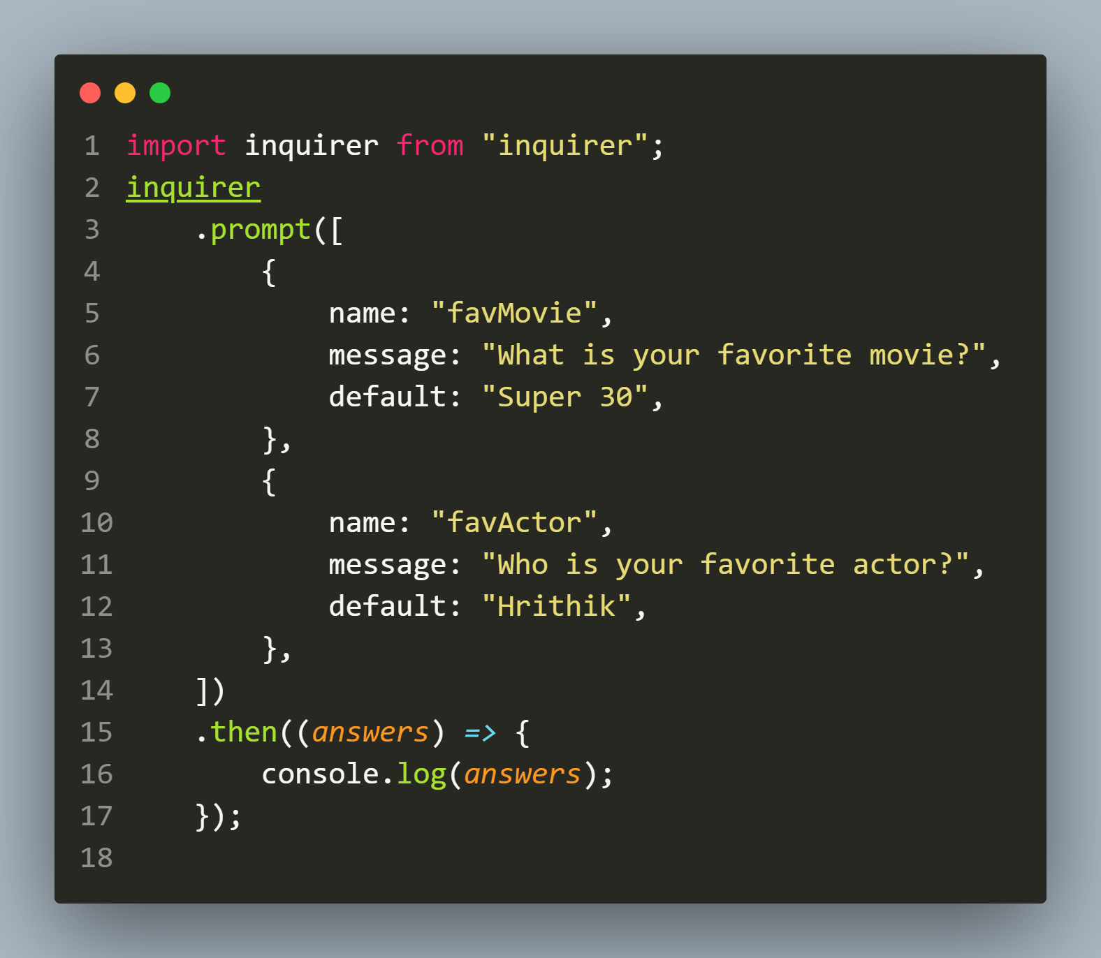
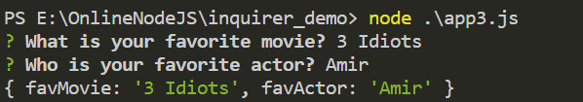
Example 3
The Code
The Output

Slide 13
Providing choices
Inquirer supports more than prompting a user for text input.
For example it can show preset options to the user and then ask him/her to make a choice.

Slide 14
Providing choices
This can be done by adding 2 more key:value pairs to the prompt() method.
They are:
type: some text
choices: an array

Slide 15
Using type:”list”
The type:”list” pair allows us to present the user with a fixed set of options to pick from, instead of a free form input as provided by the default value of type which is input

Slide 16
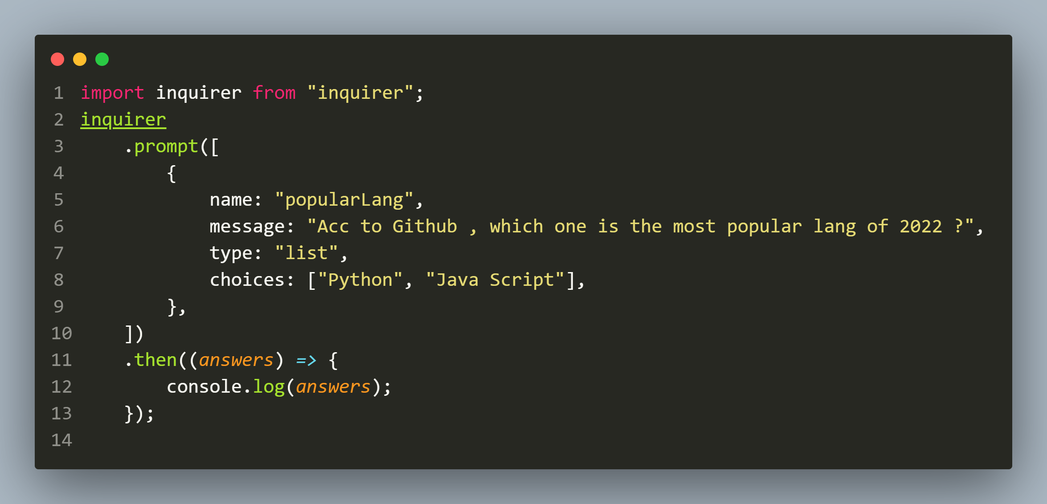
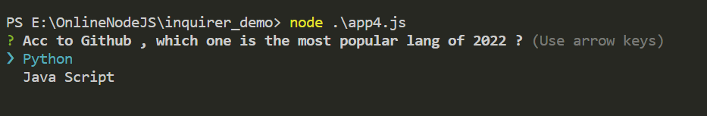

Example 4
The Code
The Output

Slide 17
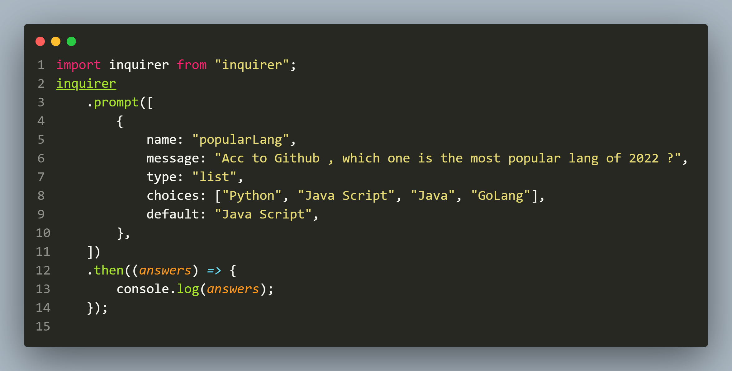
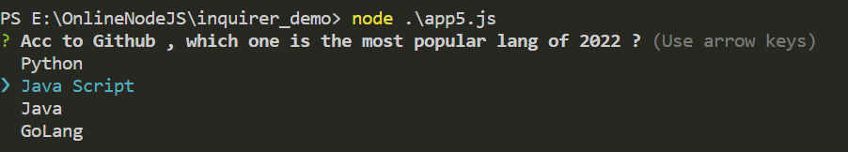
Example 5 ( using default with list)
The Code
The Output

Slide 18
Using type:”rawlist”
The type:”rawlist” is almost similar to list.
It displays a list of choices and allows the user to enter the index of their choice (starting at 1):

Slide 19
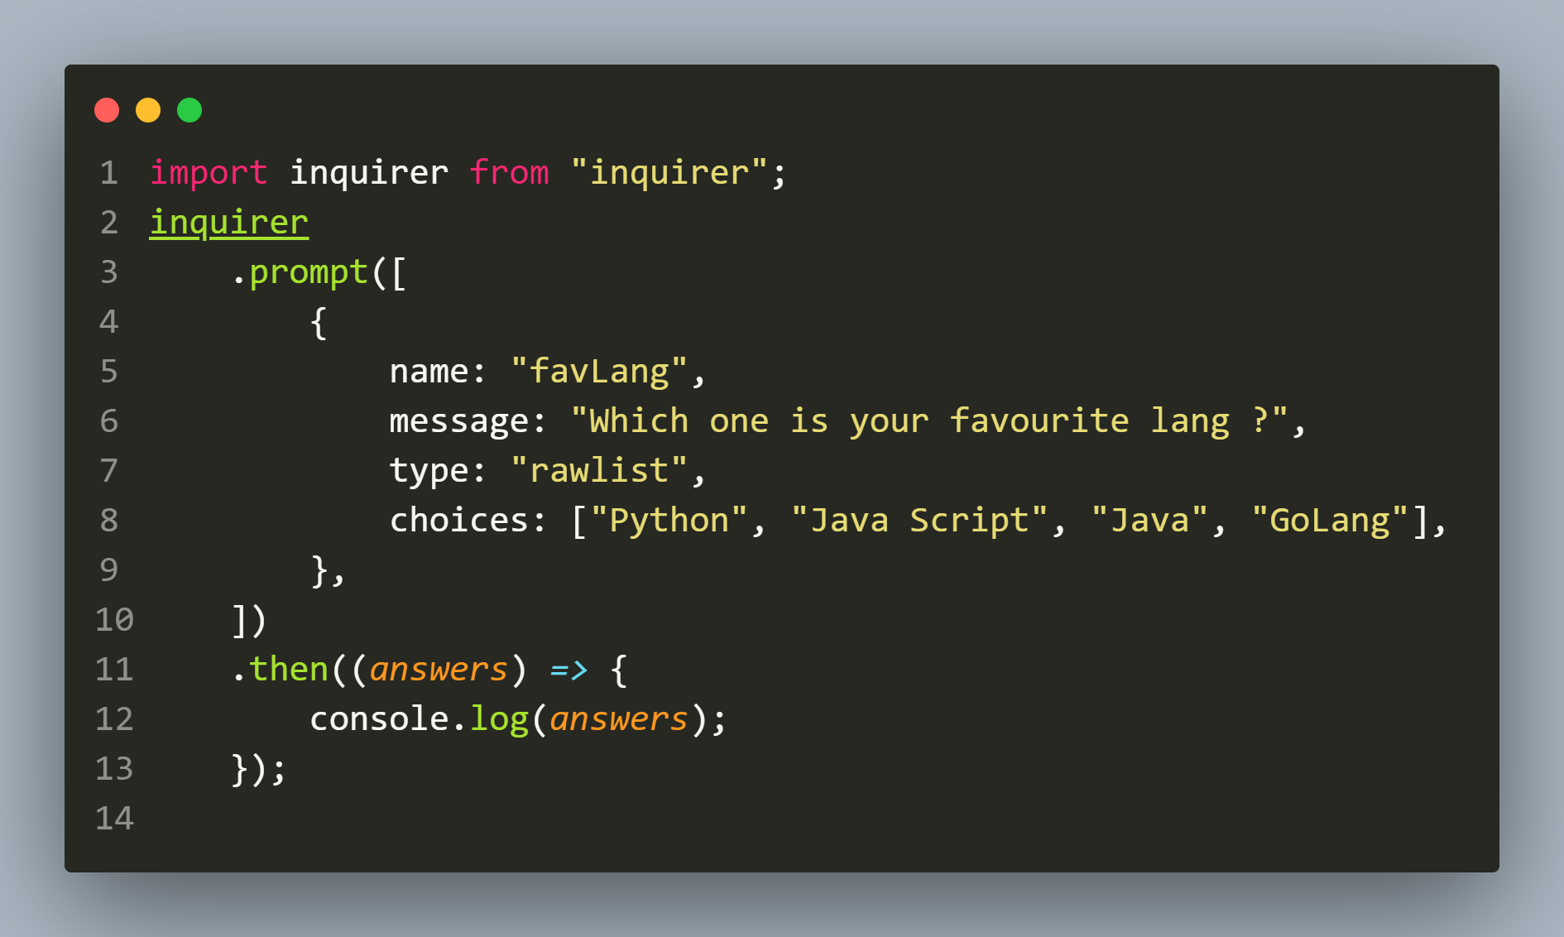
Example 6
The Code

Slide 20
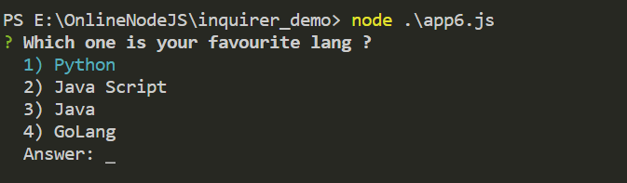
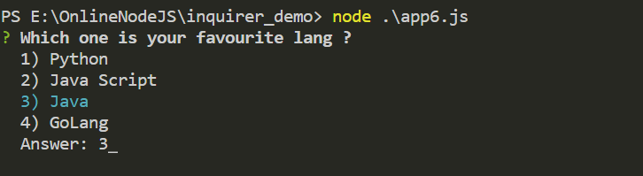

Example 6
The Output

Slide 21
Special point
If the user inputs a wrong index number as response then inquirer will display the message please input a valid index
After that it will again provide a chance to the user to input the correct answer

Slide 22
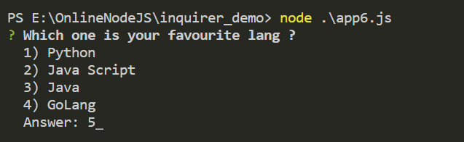
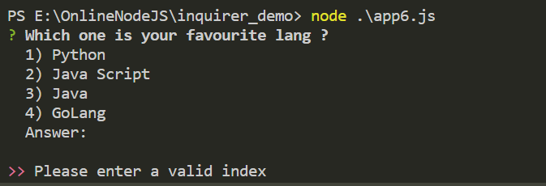
Example 6
The Output

Slide 23
Using type:”expand”
The type:"expand" is reminiscent of some command-line applications that present us with a list of characters that map to functionality that can be entered.
expand prompts will initially present the user with a list of the available character values and give context to them when the key is pressed:

Slide 24
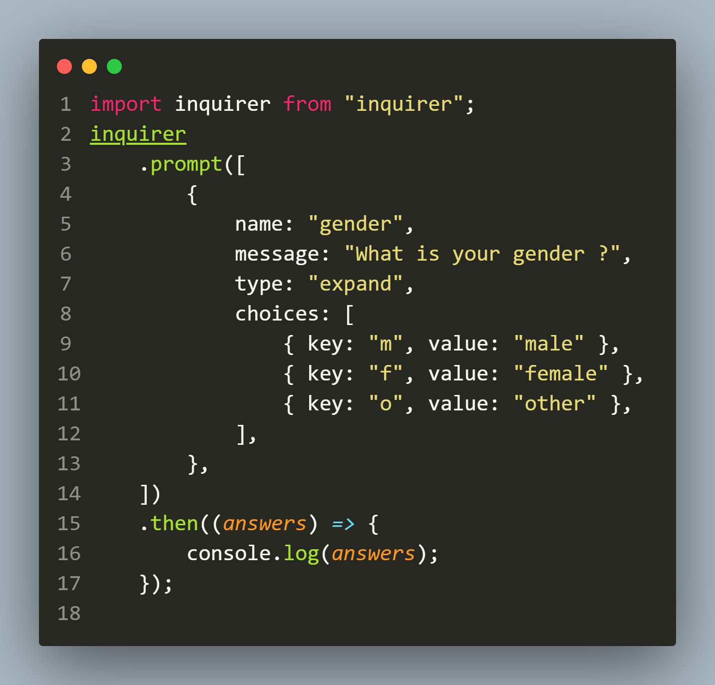
Example 7
The Code

Slide 25
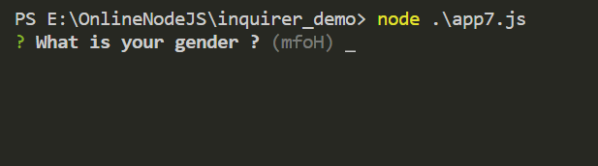
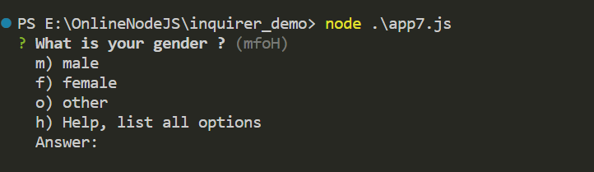
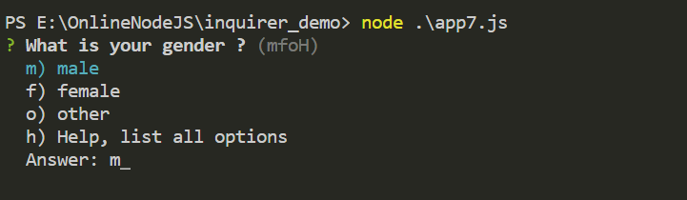

Example 7
The Output

Slide 26
Using type:”checkbox”
The type:”checkbox” is also similar to list.
The only difference is that instead of a single selection, it allows user to select multiple choices.

Slide 27
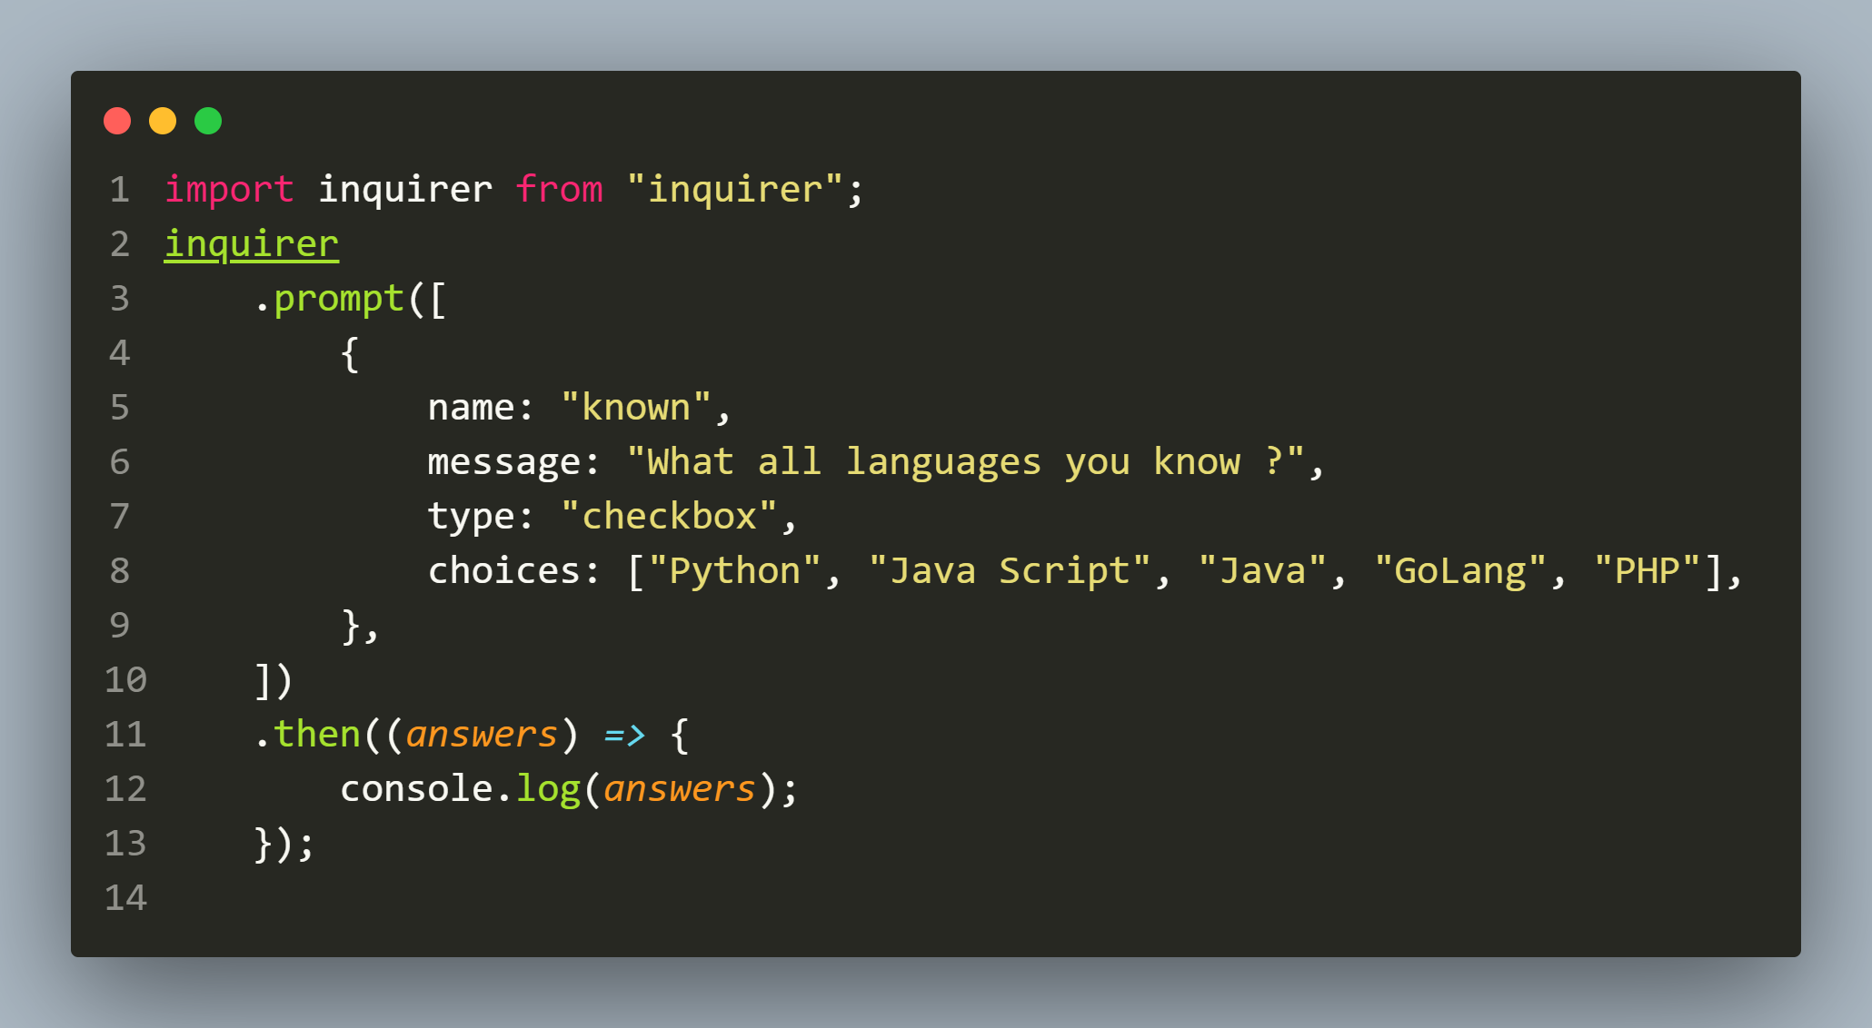
Example 8
The Code

Slide 28
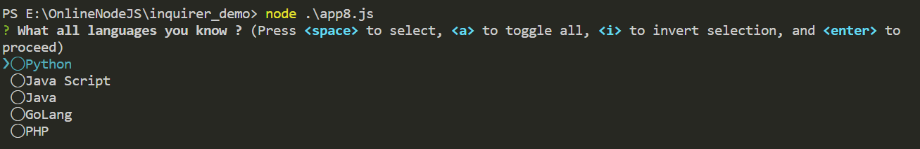
Example 8
The Output
Similar to the other list types, user can use the arrow keys to navigate.
To make a selection, he can hit SPACE and can also select all with a or invert the selection with i.

Slide 29
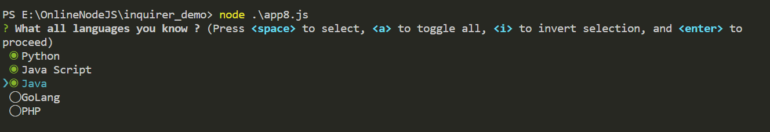

Example 8
The Output

Slide 30
Using type:”password”
The type:"password" will hide input from the user.
This allows the user to provide sensitive information that should not be seen.

Slide 31
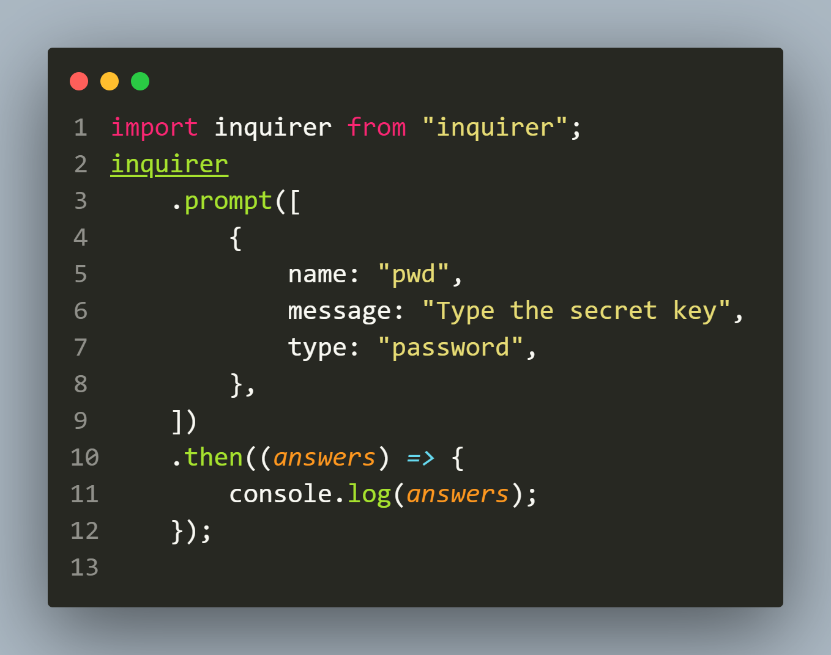
Example 9
The Code

Slide 32


Example 9
The Output

Slide 33
Project-3
Develop a QR-Code generator app.
Following are the tasks this app will perform:
Ask the user to input a URL
Validate that URL
If it is invalid then display appropriate error message and terminate
If URL is valid , then ask the user what type of QR Code image he wants to generate ( png, svg, pdf)
Validate the choice
As per the choice of image type , generate a QR Code image of the typed URL by the same name as the main url

Slide 34
Project-3
Finally it should save the generated QR Code file in a folder called qrcodes and the URL in a file called URL.txt in the same folder
Make sure to display all error messages in RED and all success messages in green
Use async-await wherever possible
The modules which you will need are:
fs
validator
chalk
inquirer
path
qr-image

Slide 35

Output ( Case 1)

Slide 36
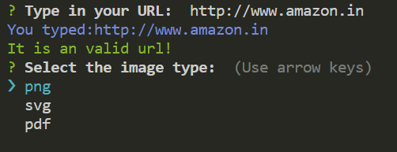

Output ( Case 2)

Slide 37
Project-3
Your app should have following functions:
getURL(): For accepting a URL as input from the user. It should return the URL typed by the user or throw exception in case of any error.
getImageType(): For asking the user to select an image type. It should return the selected image type or throw exception in case of any error
generateQRCode(): Must accept 2 arguments called url and imageType and generate and save the QR Code . It should return filename of the QR Code or throw exception in case of any error.

Slide 38
Project-3
writeToFile(): Must accept 2 arguments called filePath and url and should write the url in the given filePath. It should throw exception in case of any error.
doTask(): To call the above functions and display the message of success or error accordingly
Special Note: Use EJS import

Slide 39
Project-4
Re-design the QR-Code generator project by dividing it into 4 modules:
userinput.js: Containing functions for accepting URL and imagetype
qrcode.js: Containing function for generating and saving the QR Code
filewriter.js: Containing function for writing the url in the file
app.js: For calling all the functions from the above mentioned modules
Special Note: Use CommonJS import/export

